Slide 1

Integer Linear Programming
Rafael Almeida, Cal Thompson, Ryan Novitski

Slide 2
Introduction
Linear Programming
Integer Linear Programming
Motivation
Idea
Real World Applications
ILP is NP
ILP is NP-Hard
Reduction
Solution Verifier

Slide 3
Introduction
Linear Programming
Integer Linear Programming
Motivation
Idea
Real World Applications
ILP is NP
ILP is NP-Hard
Solution Verifier
Reduction

Slide 4

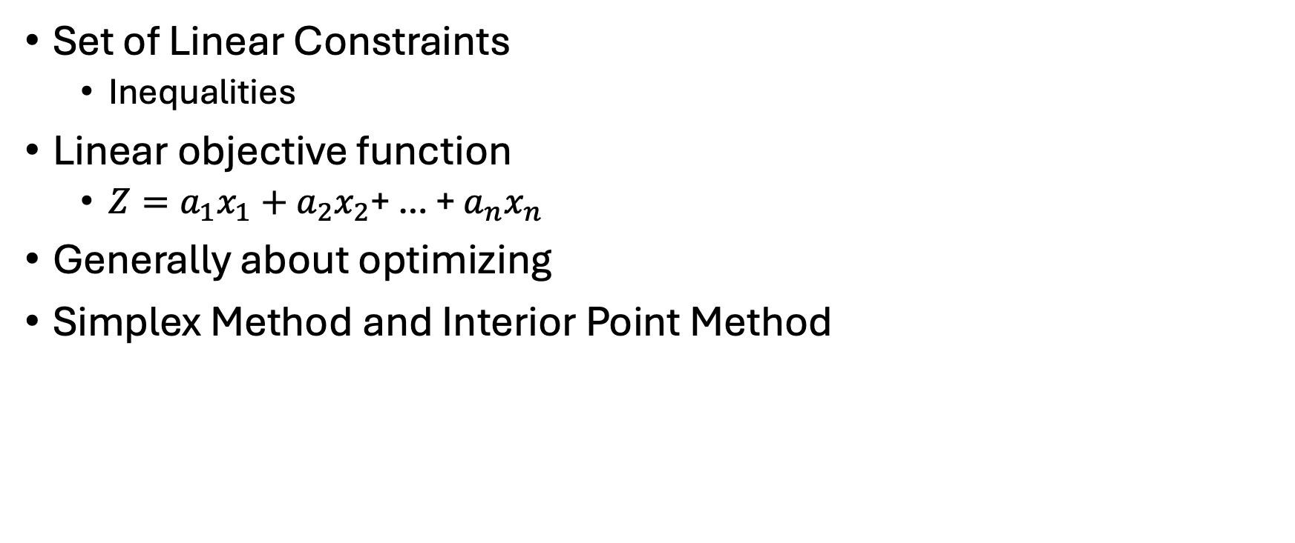
Linear Programming
Set of Linear Constraints
Inequalities
Linear objective function
$Z=a_{1}x_{1}+a_{2}x_{2}$+ … + $a_{n}x_{n}$
Generally about optimizing
Simplex Method and Interior Point Method

Slide 5
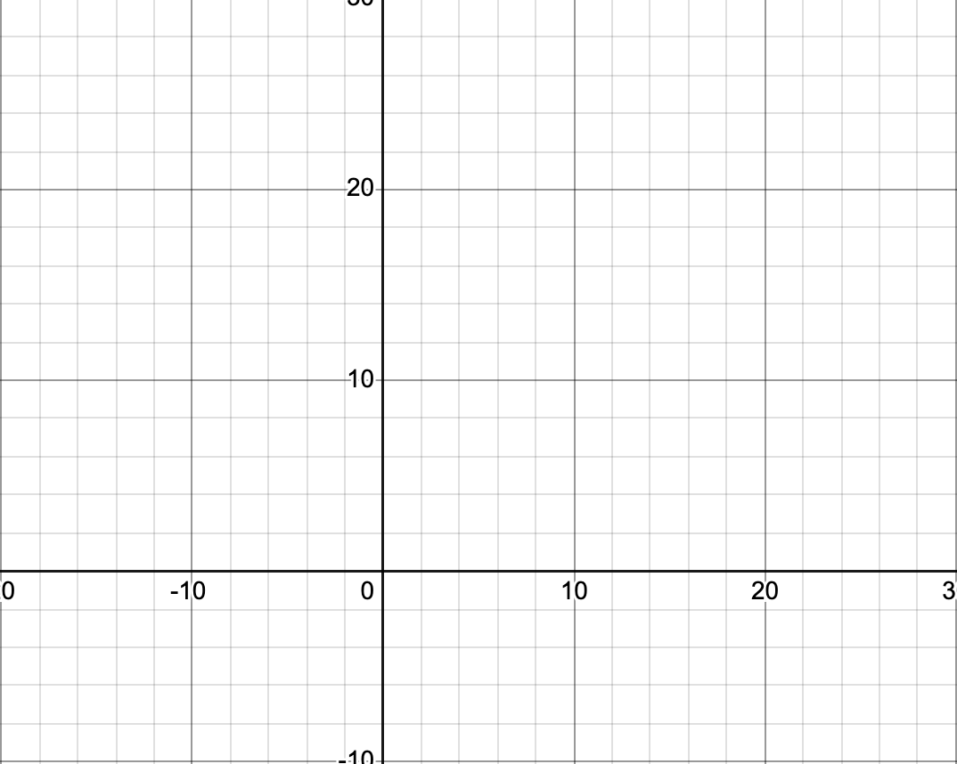
Notes:
Idea for slides taken from: https://www.youtube.com/watch?v=RhHhy-8sz-4&list=PLD3fYc0bAjC_iCOOsHZkxosZFDbcA7Kwf

Slide 6
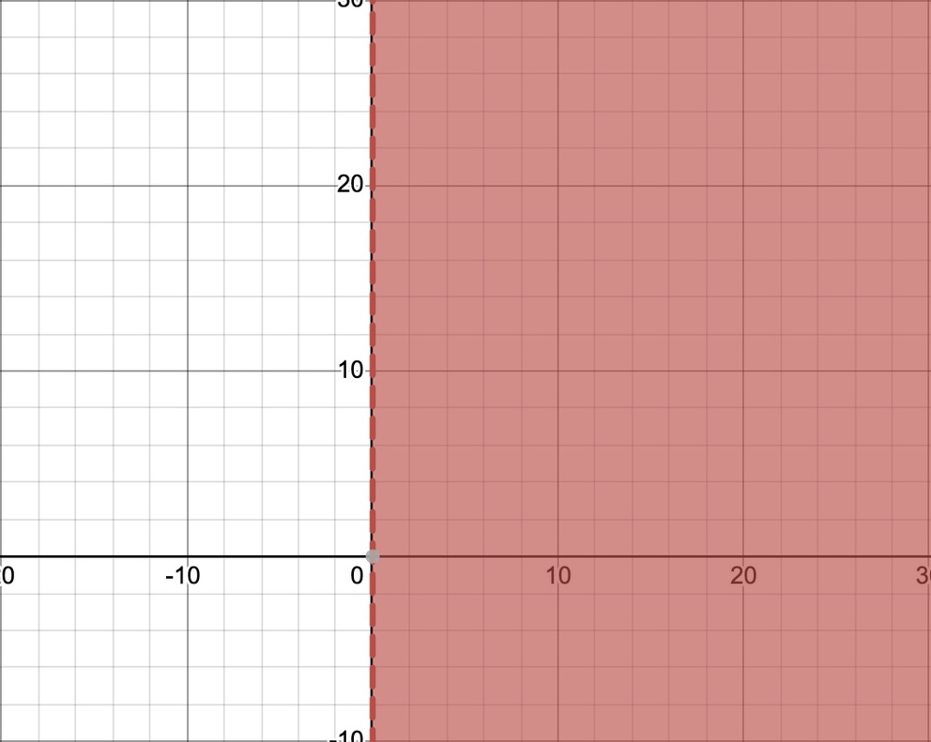

Constraints
$$x≥0$$
Notes:
Idea for slides taken from: https://www.youtube.com/watch?v=RhHhy-8sz-4&list=PLD3fYc0bAjC_iCOOsHZkxosZFDbcA7Kwf

Slide 7
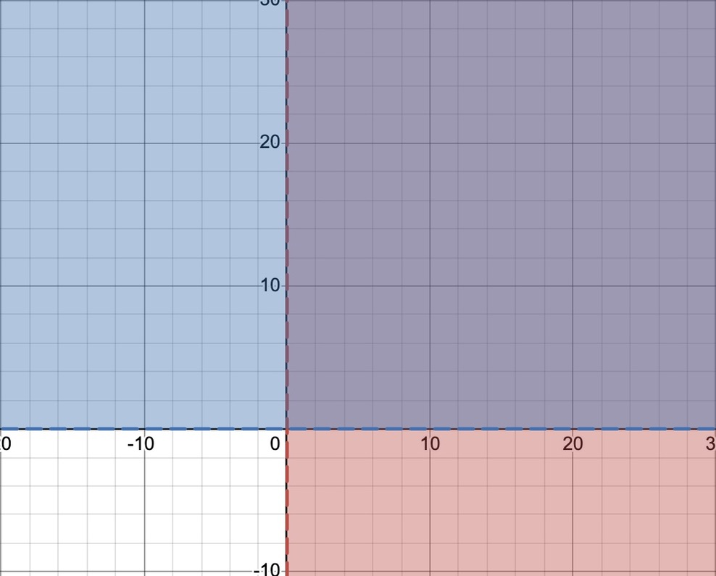

Constraints
$$x≥0$$
$$y≥0$$
Notes:
Idea for slides taken from: https://www.youtube.com/watch?v=RhHhy-8sz-4&list=PLD3fYc0bAjC_iCOOsHZkxosZFDbcA7Kwf

Slide 8
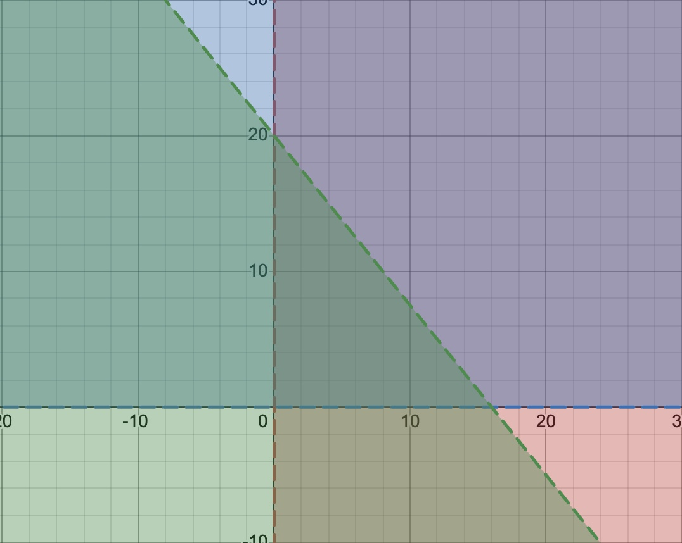

Constraints
$$x≥0$$
$$y≥0$$
$$5x+4y<80$$
Notes:
Idea for slides taken from: https://www.youtube.com/watch?v=RhHhy-8sz-4&list=PLD3fYc0bAjC_iCOOsHZkxosZFDbcA7Kwf

Slide 9
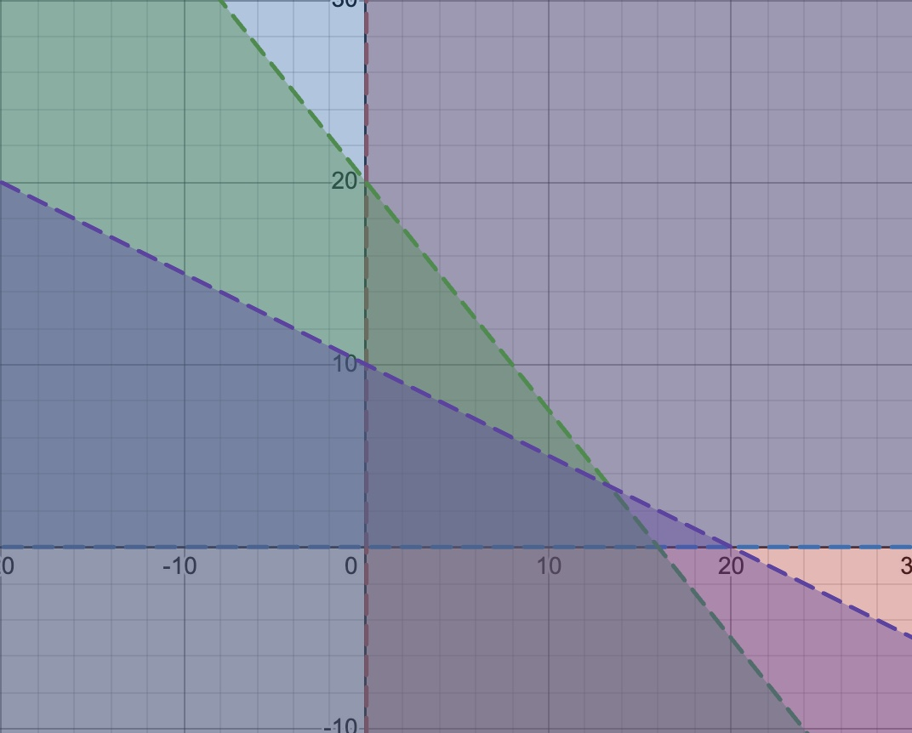

Constraints
$$x≥0$$
$$y≥0$$
$$5x+4y<80$$
$$10x+20y<200$$
Notes:
Idea for slides taken from: https://www.youtube.com/watch?v=RhHhy-8sz-4&list=PLD3fYc0bAjC_iCOOsHZkxosZFDbcA7Kwf

Slide 10
Constraints
$$x≥0$$
$$y≥0$$
$$5x+4y<80$$
$$10x+20y<200$$
Feasible Region
Notes:
Idea for slides taken from: https://www.youtube.com/watch?v=RhHhy-8sz-4&list=PLD3fYc0bAjC_iCOOsHZkxosZFDbcA7Kwf

Slide 11
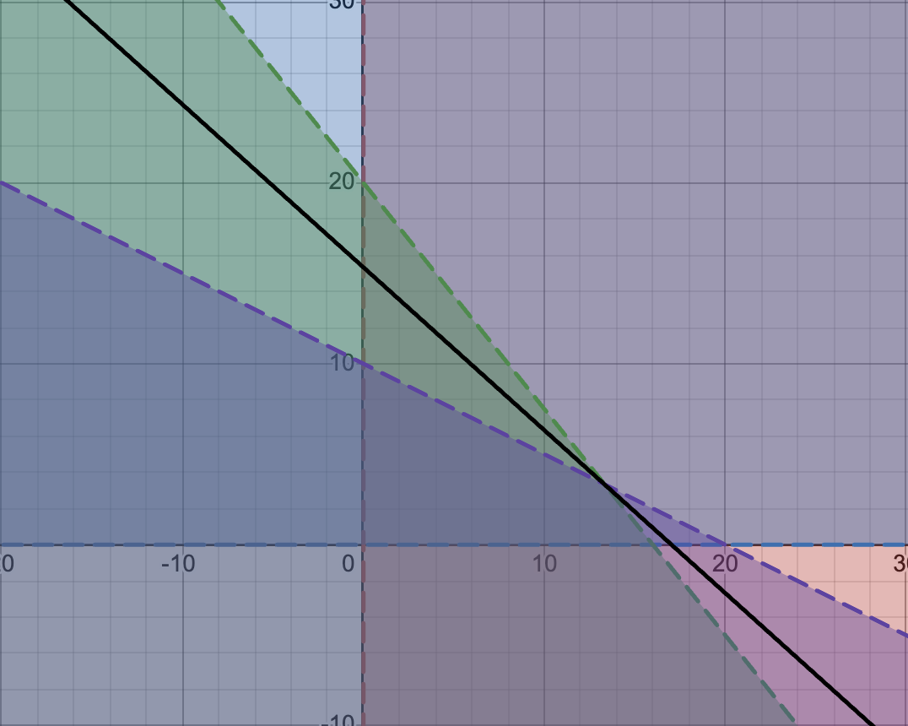
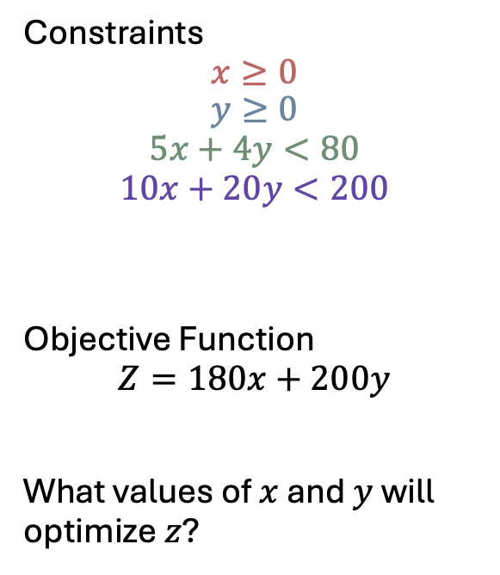
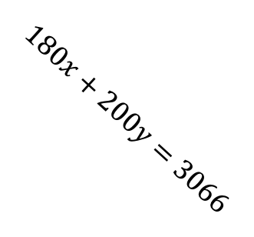
Constraints
$$x≥0$$
$$y≥0$$
$$5x+4y<80$$
$$10x+20y<200$$
Objective Function
$$Z=180x+200y$$
What values of $x$ and $y$ will optimize $z$?
$$180x+200y=3066$$
Notes:
Idea for slides taken from: https://www.youtube.com/watch?v=K7TL5NMlKIk&t=339s
Another reference: https://www.youtube.com/watch?v=K7TL5NMlKIk&t=339s

Slide 12
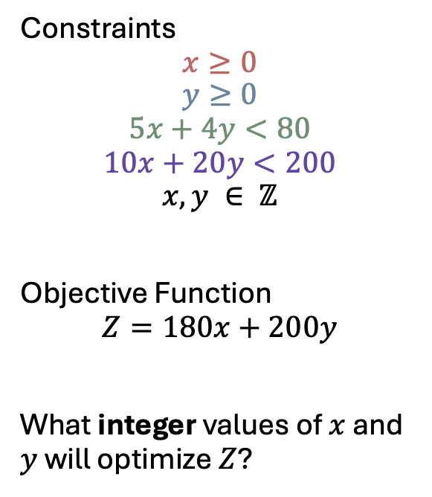
Constraints
$$x≥0$$
$$y≥0$$
$$5x+4y<80$$
$$10x+20y<200$$
$$x, y ∈ ℤ$$
Objective Function
$$Z=180x+200y$$
What integer values of $x$ and $y$ will optimize $Z$?
Notes:
Idea for slides taken from: https://www.youtube.com/watch?v=RhHhy-8sz-4&list=PLD3fYc0bAjC_iCOOsHZkxosZFDbcA7Kwf

Slide 13
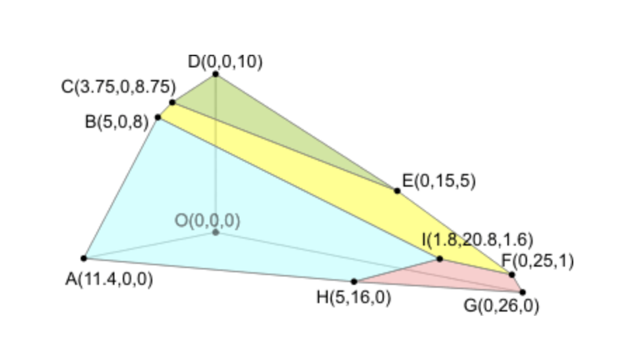
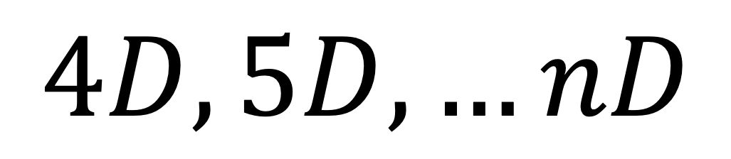
$$4D, 5D, …nD$$
Notes:
Image reference: https://people.richland.edu/james/ictcm/2006/3dsimplex.html

Slide 14
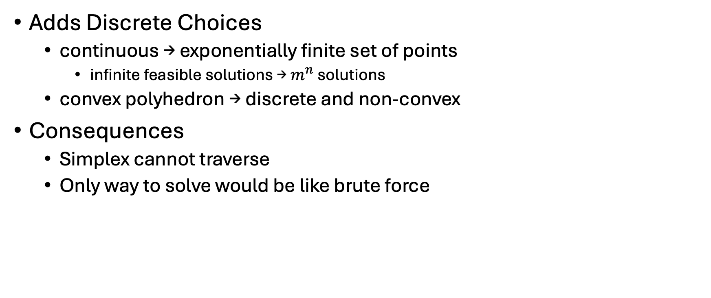
Integer Linear Programming
Adds Discrete Choices
continuous → exponentially finite set of points
infinite feasible solutions → $m^{n}$ solutions
convex polyhedron → discrete and non-convex
Consequences
Simplex cannot traverse
Only way to solve would be like brute force
Notes:
Reference: https://web.mit.edu/15.053/www/AMP-Chapter-09.pdf

Slide 15
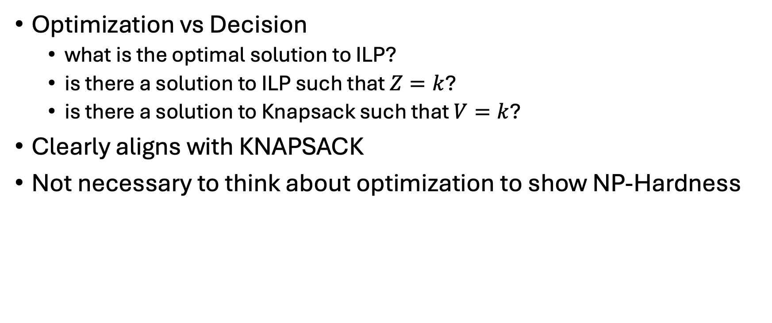
Integer Linear Programming
Optimization vs Decision
what is the optimal solution to ILP?
is there a solution to ILP such that $Z=k$?
is there a solution to Knapsack such that $V=k$?
Clearly aligns with KNAPSACK
Not necessary to think about optimization to show NP-Hardness

Slide 16
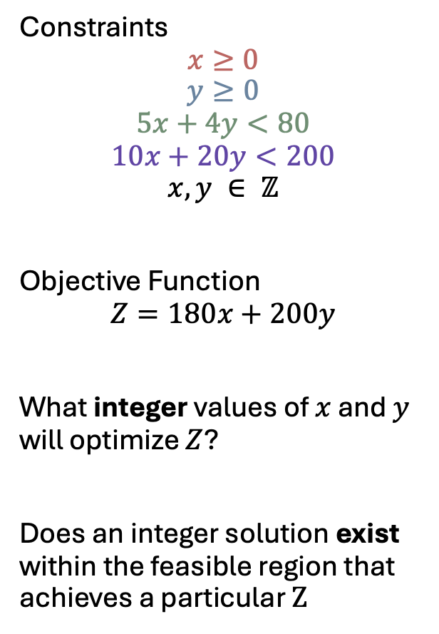
Constraints
$$x≥0$$
$$y≥0$$
$$5x+4y<80$$
$$10x+20y<200$$
$$x, y ∈ ℤ$$
Objective Function
$$Z=180x+200y$$
What integer values of $x$ and $y$ will optimize $Z$?
Does an integer solution exist within the feasible region that achieves a particular $Z$

Slide 17
Introduction
Linear Programming
Integer Linear Programming
Motivation
Idea
Real World Applications
ILP is NP
ILP is NP-Hard
Solution Verifier
Reduction

Slide 18
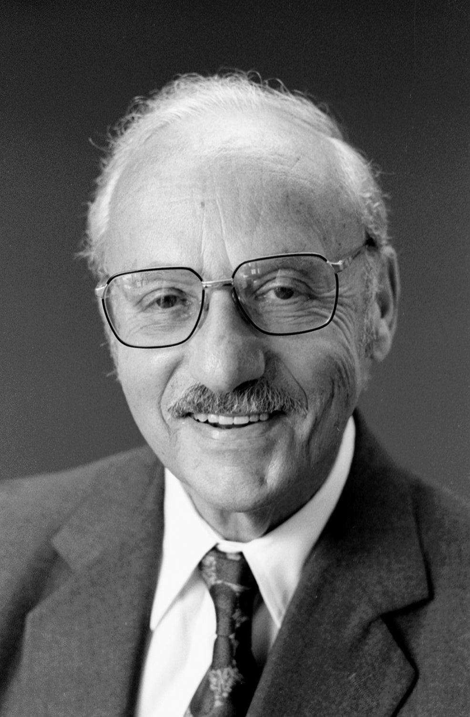

Idea
WWII’s complex planning needs
Slow and expert-dependent
George Dantzig
Shift to objective function
Notes:
Information reference: https://apps.dtic.mil/sti/pdfs/ADA112060.pdf
Image reference: https://news.stanford.edu/stories/2005/05/george-b-dantzig-operations-research-professor-dies-90

Slide 19
Real World Applications
Economics
Manufacturing
Transportation
Marketing
Notes:
Information reference: https://apps.dtic.mil/sti/pdfs/ADA112060.pdf

Slide 20
Introduction
Linear Programming
Integer Linear Programming
Motivation
Idea
Real World Applications
ILP is NP
ILP is NP-Hard
Solution Verifier
Reduction

Slide 21

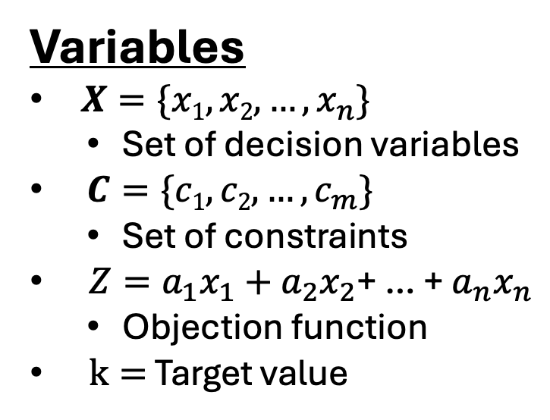
Solution Verifier Algorithm: Setup
Goal: Show that $ILP in NP$ by creating a polynomial time solution verifier.
Variables
$X=\{x1, x2, …, x_{n}\}$
Set of decision variables
$C=\{c1, c2, …, c_{m}\}$
Set of constraints
$Z=a_{1}x_{1}+a_{2}x_{2}\text{+ … + }a_{n}x_{n}$
Objection function
$k=$ Target value
Pseudocode
1 for each constraint in C :
2 for each variable in X :
3 plug variable into constraint
4 evaluate constraint
5 if constraint not met
6 do not accept
7 evaluate value of Z
8 if Z = k: 9 accept
10 else do not accept

Slide 22
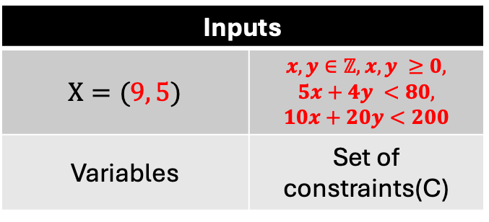
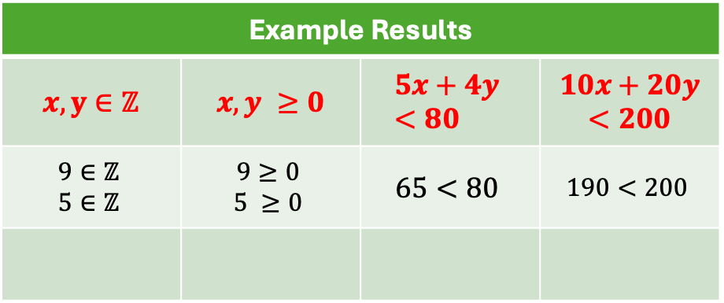
Solution Verifier Algorithm: Example
Goal: Show that $ILP in NP$ by creating a polynomial time solution verifier.
Pseudocode
1 for each constraint in C :
2 for each variable in X :
3 plug variable into constraint
4 evaluate constraint
5 if constraint not met
6 do not accept
7 evaluate value of Z
8 if Z = k: 9 accept
10 else do not accept
Inputs
$$X=(9, 5)$$ | $x,y∈ℤ,$ $x, y ≥0,$ $$5x+4y <80,$$ $$10x+20y<200$$
Variables | Set of constraints(C)
Example Results
$$x,y∈ℤ$$ | $$x, y ≥0$$ | $$5x+4y <80$$ | $$10x+20y<200$$
$$9∈ℤ$$ $$5∈ℤ$$ | $$9≥0$$ $$5 ≥0$$ | $$65<80$$ | $$190<200$$
✔
✔
✔
✔

Slide 23
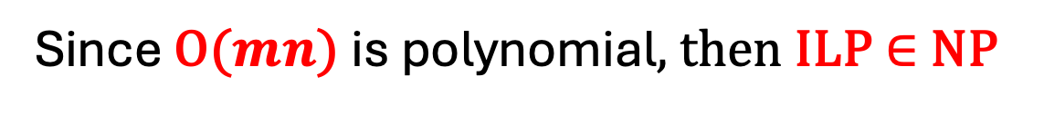

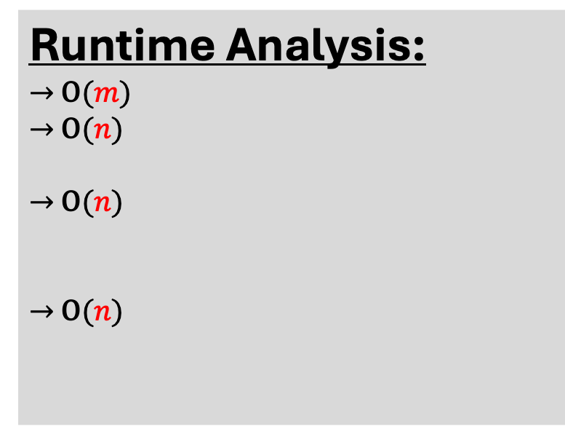
Solution Verifier Algorithm: Correctness
Goal: Show that $ILP in NP$ by creating a polynomial time solution verifier.
Pseudocode
1 for each constraint in C :
2 for each variable in X :
3 plug variable into constraint
4 evaluate constraint
5 if constraint not met
6 do not accept
7 evaluate value of Z
8 if Z = k: 9 accept
10 else do not accept
Runtime Analysis:
$→$ O($m$)
$→$ O($n$)
$→$ O($n$)
$→$ O($n$)
Overall Runtime: $O\left(m\right)∗O\left(n\right)=O(mn)$
Since O($mn$) is polynomial, then ILP $∈$NP

Slide 24
Introduction
Linear Programming
Integer Linear Programming
Motivation
Idea
Real World Applications
ILP is NP
ILP is NP-Hard
Solution Verifier
Reduction

Slide 25
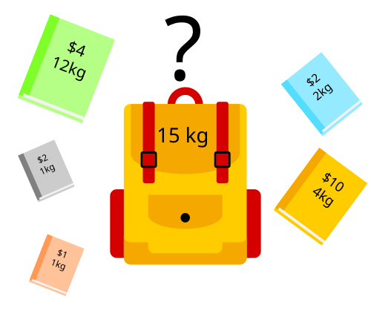
0/1 Knapsack
Notes:
Image source: https://en.wikipedia.org/wiki/Knapsack_problem
Proof by Richard M. Karp of knapsack NP-completeness and 20 other problems: https://link.springer.com/chapter/10.1007/978-1-4684-2001-2_9

Slide 26
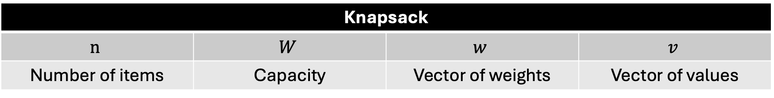
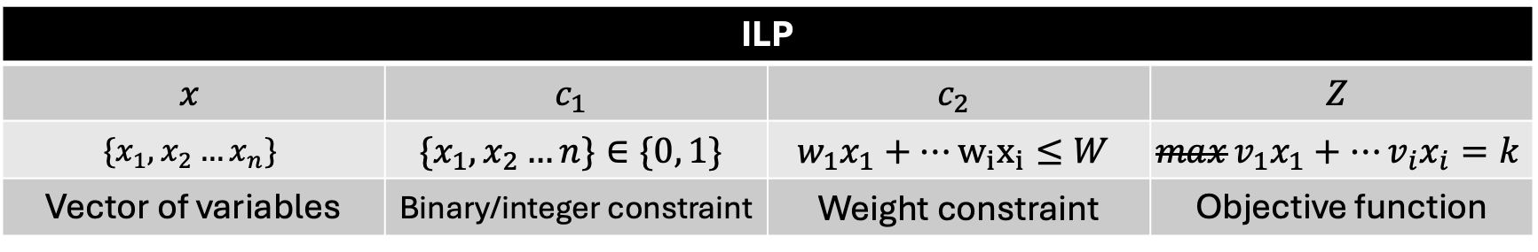
Reduction
Knapsack
$$n$$ | $$W$$ | $$w$$ | $$v$$
Number of items | Capacity | Vector of weights | Vector of values
ILP
$$x$$ | $$c_{1}$$ | $$c_{2}$$ | $$Z$$
$$\{x_{1},x_{2}…x_{n}\}$$ | $$\{x_{1},x_{2}…n\}∈\{0, 1\}$$ | $$w_{1}x_{1}+…w_{i}x_{i}≤W$$ | $$\max{v_{1}x_{1}+…v_{i}x_{i}=k}$$
Vector of variables | Binary/integer constraint | Weight constraint | Objective function
Notes:
Reduction taken from: https://youtu.be/E72DWgKP_1Y?t=841

Slide 27

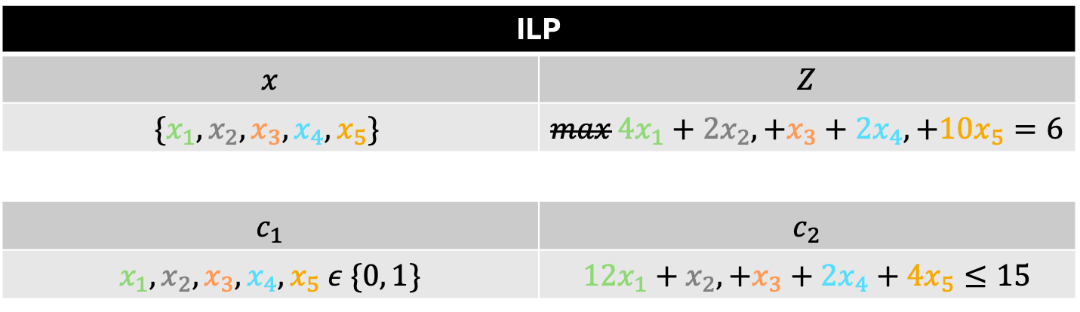
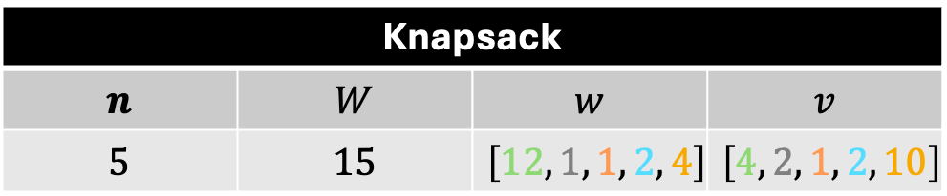
Reduction
Knapsack
$$n$$ | $$W$$ | $$w$$ | $$v$$
$$5$$ | $$15$$ | $$\left[12, 1, 1, 2, 4\right]$$ | $$\left[4, 2, 1, 2, 10\right]$$
$$K=6$$
ILP
$$x$$ | $$Z$$
$$\{x_{1},x_{2},x_{3},x_{4},x_{5}\}$$ | $$\max{{4x}_{1}+{2x}_{2},+x_{3}+{2x}_{4}, +10x_{5}=6}$$
$$c_{1}$$ | $$c_{2}$$
$$x_{1},x_{2}, x_{3},x_{4},x_{5} ε \{0, 1\}$$ | $${12x}_{1}+x_{2},+x_{3}+{2x}_{4}+{4x}_{5}≤15$$

Slide 28
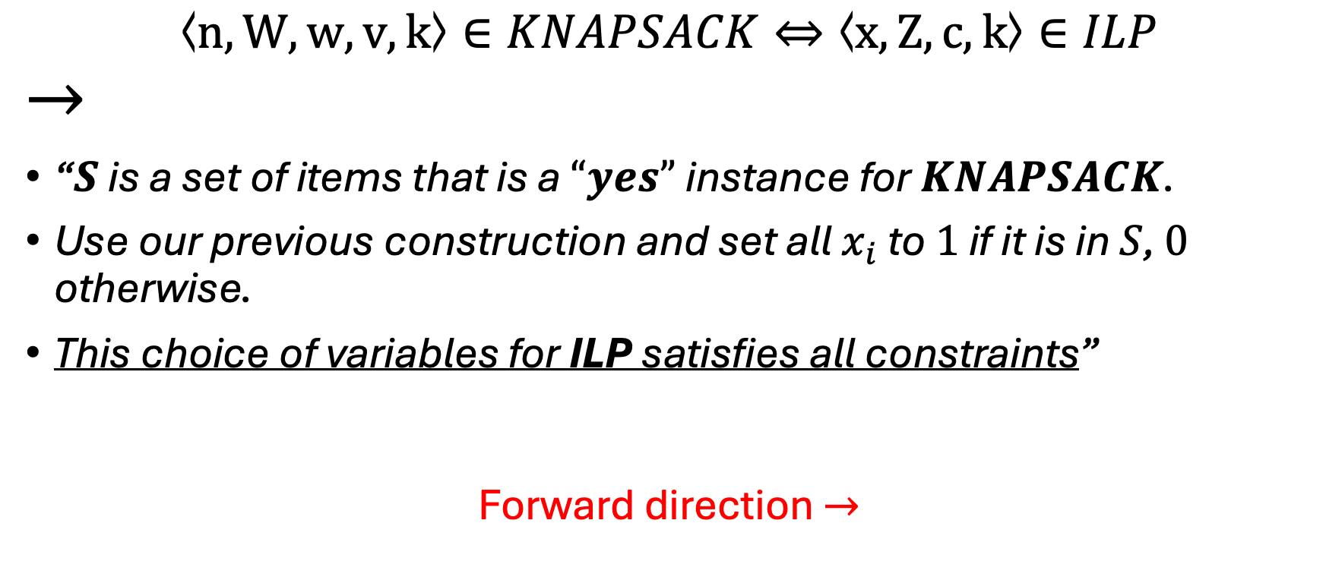
Reduction Correctness: Forward
$$\text{⟨}n, W, w,v,\text{k}\text{⟩}∈KNAPSACK⇔\text{⟨}x,Z,c,k\text{⟩}∈ILP$$
$$→$$
“$S$ is a set of items that is a $“yes”$ instance for $KNAPSACK$.
Use our previous construction and set all $x_{i}$ to $1$ if it is in $S$, $0$ otherwise.
This choice of variables for ILP satisfies all constraints”
Forward direction $→$
✔
Notes:
Satisfies all constraints: satisfies all constriants from the previous reduction, the weight constraint, and the binary constraint, both of which from the knapsack are perfectly mimicked in the ILP instance.

Slide 29
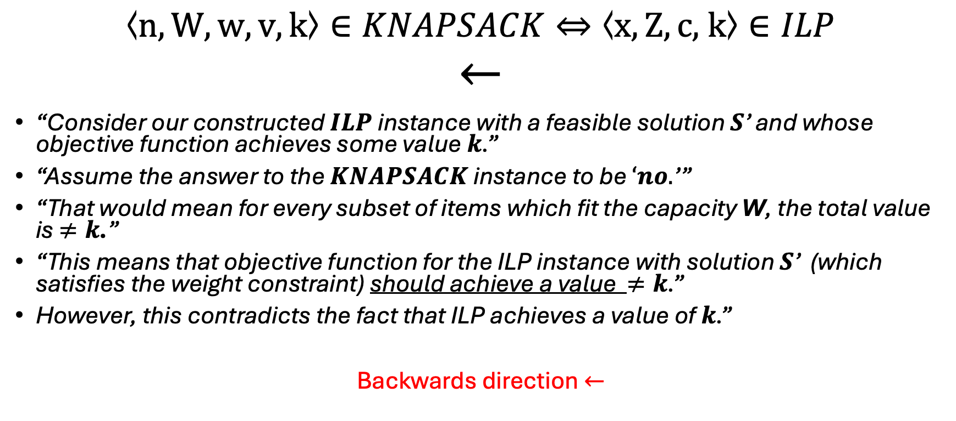
Reduction Correctness: Backward
$$\text{⟨}n, W, w,v,k\text{⟩}∈KNAPSACK⇔\text{⟨}x,Z,c\text{, }\text{k}\text{⟩}∈ILP$$
$$←$$
“Consider our constructed $ILP$ instance with a feasible solution $S$’ and whose objective function achieves some value$k$.”
“Assume the answer to the $KNAPSACK$ instance to be $‘no.$’”
“That would mean for every subset of items which fit the capacity W, the total value is $≠k$.”
“This means that objective function for the ILP instance with solution $S$’ (which satisfies the weight constraint) should achieve a value $≠k$.”
However, this contradicts the fact that ILP achieves a value of $k$.”
Backwards direction $←$
✔
Notes:
Final sentence: therefore, the knapsack instance is a yes
Should achieve a value of less than k because of our construction which says that if the knapsack achieves a value, the ILP should achieve the same

